Slide 1

Interafrican Phytosanitary Council
IAPSC
AU
Dr. Abdel Fattah Mabrouk Amer
Senior Scientific Secretary, Entomology,
AU-IAPSC

Slide 2
A brief historical background
IAPSC was Created in 1954 in line with the recommendation by FAO requesting establishment various regional plant protection and effected in 1956 in London and became part of the TCCA in 1960. In 1965 it became a part of STRC and supported by the Organization of African Unity (OAU) and its activities was extended to cover all Member States. 1967 its offices transferred from London to Yaounde - Cameroon, after the recommendation of Heaads of States and Governments of OAU. And in April 1969 The name Inter-African Phytosanitary Commission became the Inter-African Phytosanitary Council fully managed by the OAU Secretariat and member countries.

Slide 3
Our Challenges
* For plants production Systems highly likely to be attacked by pests.
* Economic losses due to product deterioration
* Non-compliance with standards and other regulations,
* Lack of data on risk analysis, pests diagnosis and monitoring.

Slide 4
Vision
* Ensure that sufficient food and feed, with satisfying quality, is available at any point for the entire population of the African Continent.
* Ensure that African Agriculture exports increase and meet world market standards at competitive prices.
* Formulate environmentally acceptable plant protection policies and practices that are safe for human health and do not impede trade and/or exchange in plants and plant products.

Slide 5
Mission
* Coordinates plant protection procedures in Africa, promotes the gathering and dissemination of information and facilitates collaboration between the 53 National Plant Protection Organizations (NPPO's) of the continent in terms of:
* technical justification of phytosanitary measures,
* sustainable and effective protection of plants and
* harmonization based on scientific methods and procedures.
* Respect of FAO International Code of Ethics regarding pesticides distribution and use

Slide 6
Our Mandate
Preventing the introduction of crop pests and diseases into Africa
Controlling and/or eradicating endemic pests and diseases in Africa
Mitigating Discouraging uncontrolled marketing agro-chemicals into and within Africa
Ensure safe use of plant protection material and minimising toxicological implications of agro-chemicals on public health.
Provide guidance to Member States on the implications of biotechnologies for plant protection and food safety.
Actively participate in strengthening member states to comply with the requirements of the WTO-SPS Agreement.

Slide 7
Core Functions /
Institutional Objectives
Development and management of information to serve African and International Plant Protection Organisations
Harmonisation of Phytosanitary regulations in Africa
Development of regional strategies against the introduction and spread of plant pests
Training of various cadres of NPPO personnel in Pest Risk Analysis (PRA), Phytosanitary inspection and treatment, field inspection and certification, laboratory diagnoses, pest surveillance and monitoring etc.

Slide 8
Our Activities
Our Activities
* Collect, evaluate and disseminate plant protection information to Africa.
* Promote Integrated Plant Protection and Production Management.
* Coordinate plant protection activities on regional and sub-regional levels in collaboration with relevant institutions.
* Promote International conventions on phytosanitary measures.
* Organize meetings on training, coordination and transfer of technologies.
* Advise national agricultural decision makers on plant protection.
* Liaise between the public and the private sectors.
* Set up sector research and agricultural production networks.
* Articulate the needs of African plant protection organizations at international commissions, conferences, etc.
* Harmonize the pesticides regulations

Slide 9
Institutional Structure
General Assemble
Steering Committee
Direction IAPSC
Entomologist
Phytopathologist
Administration &Finances
Documentation

Slide 10
Scientific Secretariat of IAPSC
DIRECTION : 1: Le Directeur
SECTION ENTOMOLOGIE :
01 Senior Scientific Secretary Entomologist,
01 Assistant to SSSE,
SECTION PHYTOPATHOLOGIE:
01 Senior Scientific Secretary Phytopathologist,
01 Assistant to SSSP,

Slide 11
Principal aspects
Entomology: (Take care from insects, acarose, locusts, grain eating birds, plant quarantine, Stored product, IPM, legistelatoin, harmonization, «pests and pesticides» … etc)
Phytopathology: (Plant diseases, plant quarantine, IPM, legistelatoin, , etc…)

Slide 12
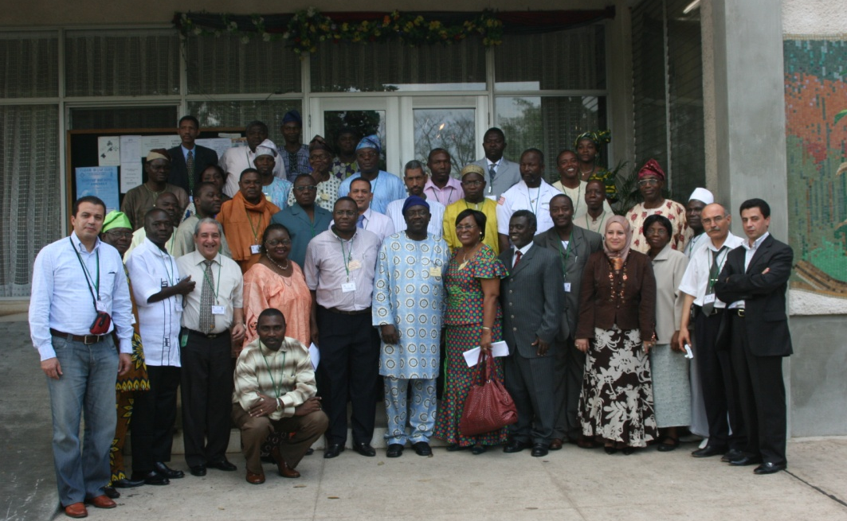
Example of Our Activities
2007
In 2007 (13-17 December, 2007) We established training with UMA and ECOWAS (THE UMA –ECOWAS JOINT REGIONAL TRAINING WORKING FOR PHYTOSANITARY INSPECTORS AND QUARANTINE OFFICERS) held in IITA (Ibadan, Nigeria).

Slide 13
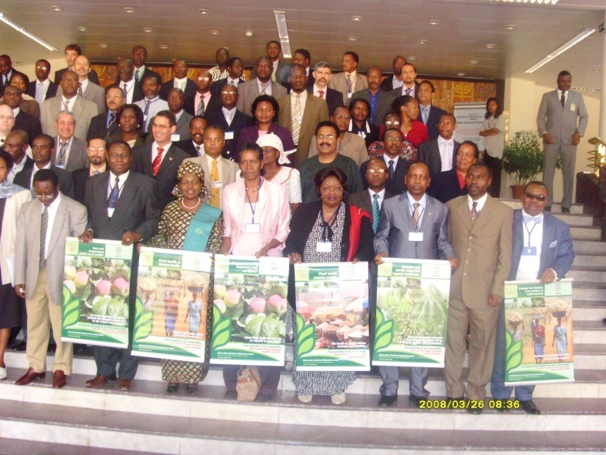
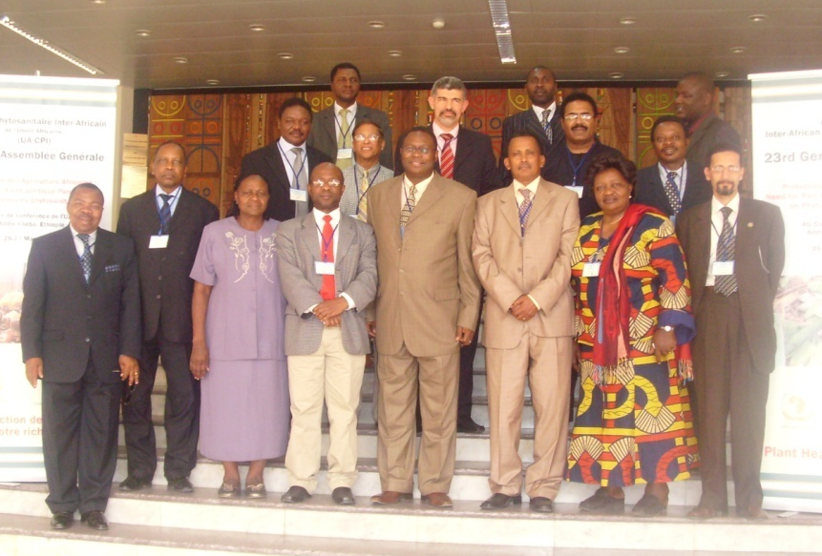
2008
Three meeting were held in AUC in Addis Ababa during the period from 22nd march to 28th March, the 1st one is experts meeting, from 22-23 March followed by Steering committee in 24 and 25 March and finally our general assembly from 26 to 28 March.

Slide 14
2008
Participation meeting in Johannesburg with SADC to attend a Regional Meeting in preparation for participation at the 3rd session of the CPM3.
Start projet PAN-SPSO with IBAR in Nairobi Kenya, and also CABI
Meeting on the Scoping study of the Impact of Fumigation and Inspection issues on the safe Trade in Agricultural Communities in the Economy of West and Central African Countries (DOUALA – CAMEROON 11-12 March, 2009)

Slide 15
2008
Meeting on the Harmonization of homologation of chemicals pesticides in Eastern and Southern Africa (February 2009, Addis Ababa).

Slide 16
2009
Meetings and trainings workshops for reclassification and improving integrated pesmanagement (IPM) for fruit flies in Africa
Control phenomenon of the Transboundary pests in Africa: Grain Eating Birds (Quelea sp) invasions in Africa.
Strengthening continent-wide Cassava protection initiative against major diseases
Updated spatial and temporal analysis of pests and plant disease in Africa

Slide 17
2010
Meetings and trainings workshops for reclassification and improving integrated pest management (IPM) for fruit flies in Africa (phase II East and South Africa)
Harmonization of homologation of chemicals pesticides in Eastern and Southern Africa (Phase II, UMA and ECOWAS)
Capacity building for Management of Grain Eating Birds (Quelea quelea) Control in East and Southern Africa Sub Region (Phase III)
Capacity building of National Plant Protection Organizations (NPPO`s) for Integrated Pest Management and pest reporting to enhance agricultural trade and regional integration. PhaseI
Strengthening continent-wide Cassava protection initiative against major diseases; Phase II
Updated spatial and temporal analysis of pests and plant disease in Africa (Phase II, COMESA and ECOWAS)

Slide 18
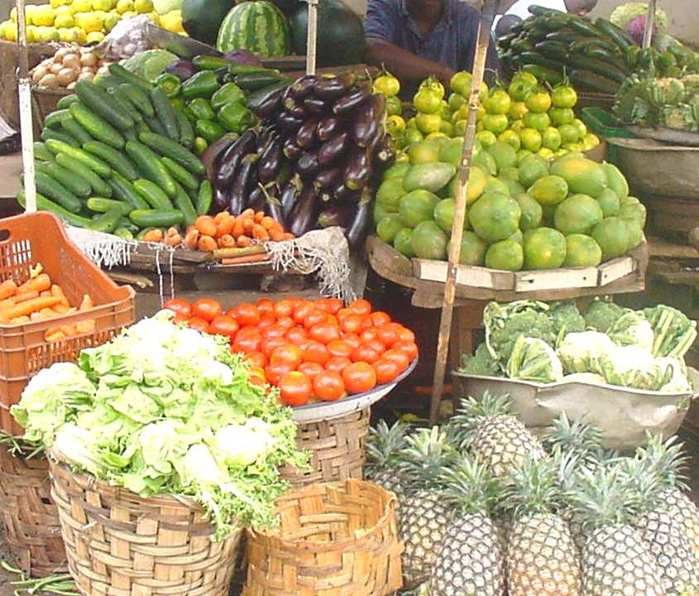
Thanks
THANKS

